Slide 1






PRESENTATION 2026
Student Name
Student Email
sk nazeema
nazeemajid987@gmail.com
Mentor Name
umamaheshwari

Slide 2

Outline
Abstract of the Project
Problem Statement
Proposed Solution
System Architecture
Live Demo of the Project
Embedded Video of Project
Conclusion
Future Scope

Slide 3

Abstract
This project analyzes tourism booking data to improve business decision-making.
The dataset contains around 1500 tourism booking records.
Microsoft Excel is used for data cleaning and analysis.
Power BI is used to create dashboards and visual reports.
Microsoft Copilot helps generate AI insights.
The project identifies revenue trends, booking patterns, and cancellation behavior.

Slide 4

Problem Statement
3. Problem Statement
Tourism businesses often face high booking cancellations.
Many businesses do not analyze their booking data properly.
Lack of analytics leads to poor pricing and revenue loss.
Managers cannot easily identify customer behavior and booking trends.

Slide 5

Proposed Solution
Use Excel to clean and validate booking data.
Use Power BI to create dashboards and visualizations.
Use Copilot AI to generate insights and recommendations.
Provide clear reports for business decision-making.

Slide 6
System Architecture
Data Input / Source
Processing / Analysis
Tourism booking data set
Excel formulas and power BI
AI / Tool Integration
Output / Dashboard
Microsoft excel
Interactive dashboard and business insights

Slide 7
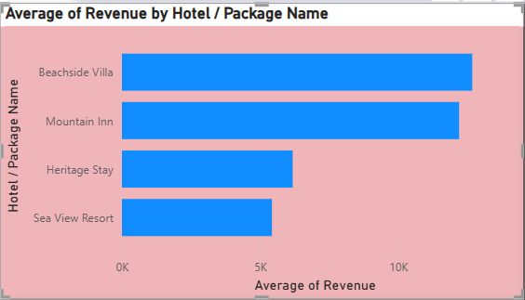
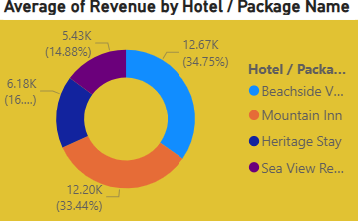
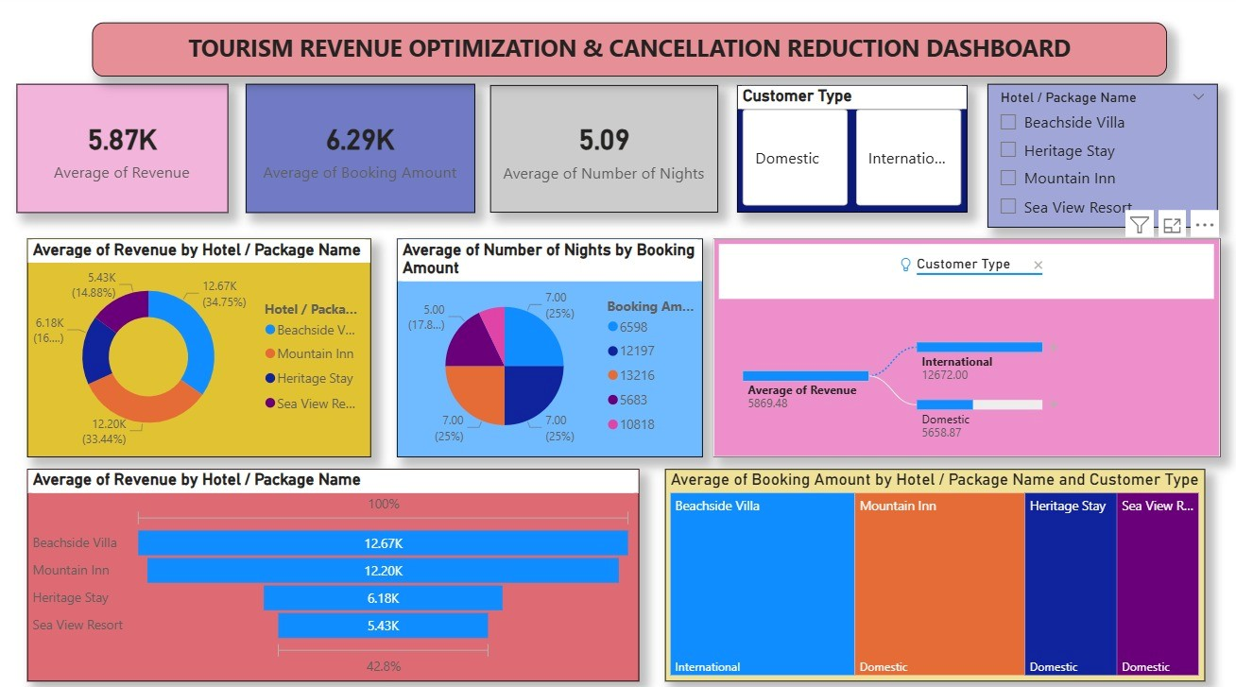
Live Demo of Project
Here's the list of some demo screenshots / features of the project:

Slide 8
Video of Project Demo
[https://your-project-demo-link.com]
https://drive.google.com/file/d/16InB1mO5MSW9D01p7EYqyuckGuR9NJt-/view?usp=sharing
▶
[Insert your project demo video.
You can embed a video your live project.]

Slide 9

Conclusion
The project shows that Excel, Power BI, and Copilot can transform raw data into useful insights.
Businesses can use these insights to improve pricing strategies and reduce cancellations.
Data analytics helps tourism businesses make faster and smarter decisions.
CONCLUSION

Slide 10

Future Scope
Integrate real-time booking data.
Use AI forecasting for demand prediction.
Add customer behavior analysis using machine learning.
Develop automated business dashboards.

Slide 11
Thank You
AICW Fellowship | Student Project Presentation 2026
LinkedIn | Edunet Foundation

